Slide 1
Agile Testing
2025
Poornima

Slide 2
Introduction to Agile
What is Agile?
Agile is a project management and software development approach that emphasizes flexibility, collaboration, and customer-centricity.
Instead of rigid, sequential processes (like Waterfall), Agile uses iterative cycles (sprints) to deliver small, usable increments of a product.
Core principle: “Responding to change over following a plan.”
Agile is a flexible, iterative way of working that focuses on:
Delivering value quickly
Adapting to change
Continuous feedback
Team collaboration

Slide 3
Introduction to Agile
Why Agile?
Traditional methods often fail in fast-changing environments. Agile was created to adapt quickly to evolving requirements.
Agile helps teams:
Deliver faster
Reduce risk
Improve quality
Respond to change
Increase transparency
Collaborate better

Slide 4
Benefits of Agile in Modern Projects
🚀 Speed & Flexibility – Quick adaptation to market changes.
🤝 Collaboration – Stronger communication between teams and stakeholders.
✅ Quality – Continuous testing and feedback improve product reliability.
💡 Innovation – Encourages experimentation and creativity.
📈 Customer Satisfaction – Frequent delivery ensures customer needs are met early and often.
🔄 Reduced Risk – Problems are identified early, minimizing costly failures.

Slide 5
Agile vs Waterfall
Category | Waterfall | Agile
Approach | Linear, sequential phases | Iterative, incremental cycles (sprints)
Flexibility | Rigid; changes are difficult once development starts | Highly flexible; changes welcomed anytime
Delivery | Delivered only at the end of the project | Delivered in small increments throughout
Customer Involvement | Low; mainly at start and end | High; continuous involvement and feedback
Planning | Heavy upfront planning | Adaptive planning each sprint
Testing | Happens after development phase | Continuous testing throughout the sprint
Risk Management | High risk — issues found late | Low risk — issues found early and often
Team Collaboration | Siloed teams (Dev → QA → Release) | Cross‑functional teams working together daily
Documentation | Extensive documentation upfront | Just‑enough documentation to support delivery
Requirement Stability | Works best when requirements are fixed | Works best when requirements evolve
Project Visibility | Low visibility until late stages | High visibility with frequent demos
Change Cost | Expensive and time‑consuming | Low cost due to iterative cycles
Best For | Construction, manufacturing, regulated projects | Software development, dynamic environments

Slide 6
Agile principles
Deliver value early and often
Welcome changing requirements
Collaborate daily
Build around motivated teams
Reflect and improve regularly

Slide 7
What is Scrum?
Scrum is:
A lightweight Agile framework
A structured way to work in iterations
Focused on delivering increments of value

Slide 8
What is Scrum?
Scrum is:
A lightweight Agile framework
A structured way to work in iterations
Focused on delivering increments of value

Slide 9
Scrum Roles
Development Team (Dev Team)
Purpose: Builds and delivers the product increment.
Key Responsibilities:
Cross‑functional group (Dev, QA, QE, UX, etc.)
Self‑organizing — they decide how to do the work
Collaborate daily to deliver a Done, usable increment
Estimate and commit to sprint work
Maintain quality through coding, testing, automation, and reviews
Scrum Master (SM)
Purpose: Ensures the team follows Scrum effectively.
Key Responsibilities:
Facilitates Scrum ceremonies (Daily Scrum, Planning, Review, Retro)
Removes blockers and impediments
Coaches the team on Agile principles
Protects the team from distractions
Helps improve team processes and collaboration
Product Owner (PO)
Purpose: Maximizes product value.
Key Responsibilities:
Owns the product vision
Manages and prioritizes the Product Backlog
Defines what the team should build and why
Works closely with stakeholders and customers
Ensures the team is always working on the most valuable items

Slide 10
Scrum Events (Ceremonies)
Sprint Planning – What we will deliver
Daily Scrum – 15‑minute alignment
Sprint Review – Demo the increment
Sprint Retrospective – Improve the process
Sprint – 1–4 week iteration

Slide 11
Scrum Artifacts
Product Backlog
All work items, prioritized
Sprint Backlog
Items selected for the sprint
Increment
The working product delivered at the end

Slide 12
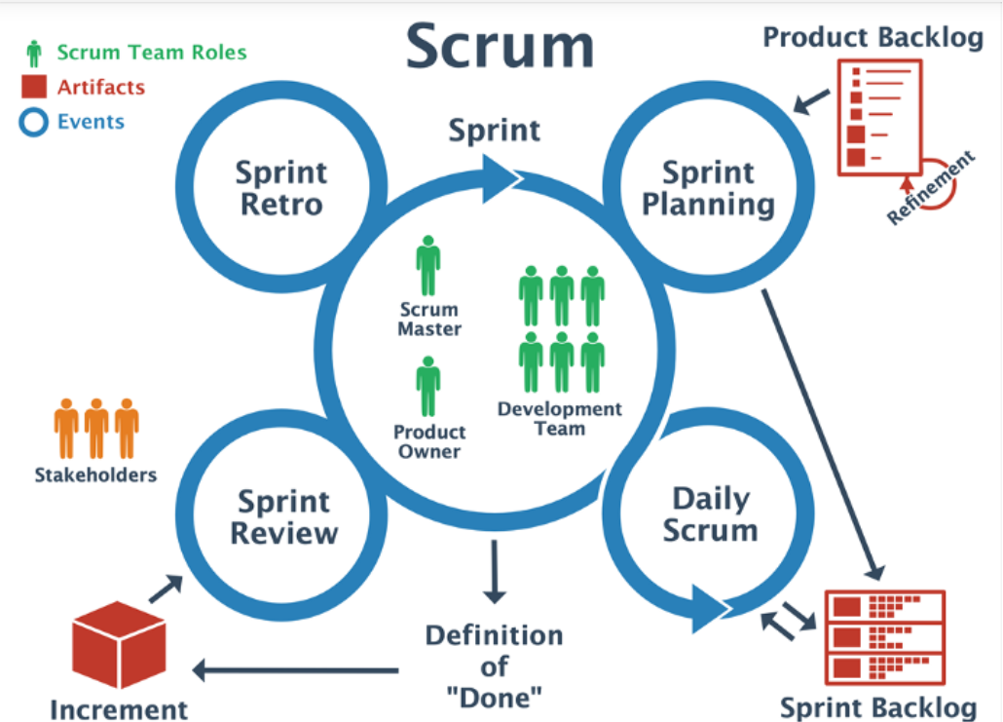
Sprint Cycle

Slide 13
DoR and DoD
The Definition of Ready (DoR) is a list of criteria that must be met in order for a product backlog item (PBI) to be considered "ready" for development.
A story is ready when:
Clear description
Acceptance criteria defined
Dependencies identified
Testable
A story is done when:
Code complete
Tested (unit + functional)
Reviewed
Integrated
Meets acceptance criteria
The DoD is a list of criteria that must be met in order for a product backlog item (PBI) to be considered "done."

Slide 14
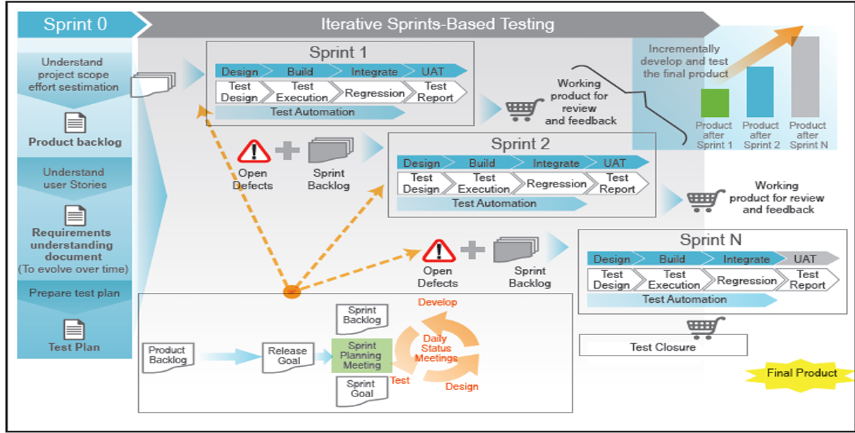
Typical QA approach for Agile projects

